Slide 1
Personal VAD: Speaker-Conditioned Voice Activity Detection
Authors: Shaojin Ding, Quan Wang, Shuo-yiin Chang, Li Wan, Ignacio Lopez Moreno
Presented by: Quan Wang <quanw@google.com>
Notes:
Paper: https://arxiv.org/abs/1710.10467

Slide 2
Key messages
What:
A system to detect the voice activity of a target speaker
Why:
Reduces CPU, memory and battery consumption for on-device speech recognition
How:
Frame-level streaming detection
Speaker embedding as side input

Slide 3
Part 1:
Background

Slide 4
On-device ASR
Moving ASR from cloud to device is the trend
No requirement for Internet
Much less latency due to communications
Better security and privacy preservation
Example use cases (smartphones, smart home devices):
“Turn on flashlight”
“Turn on bedroom lights”

Slide 5
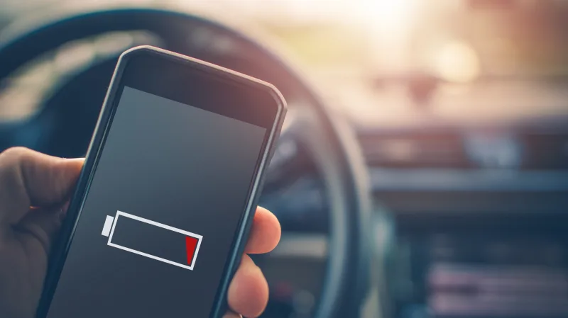
Challenges for on-device ASR
Limited CPU
Limited memory
Limited battery
ASR is not alone – many other programs running on the device

Slide 6
On-device ASR: When to run it?
On-device ASR can’t be always running
Typical solution: Keyword detection (a.k.a. wakeword or hotword)
Keyword detection: Very cheap, always running
ASR: Expensive, only runs when keyword is detected
Example:
“Hey Google, turn on flashlight”

Slide 7

On-device ASR: When to run it?
However, many people prefer keyword-less interactions
More seamless, more natural, more intelligent
Alternative solution: Voice Activity Detection (VAD)
VAD: Very cheap, always running
ASR: Expensive, only runs when VAD triggers

Slide 8
VAD: Rejects non-speech signals
Each frame is categorized as non-speech (ns) or speech (s)
Only run ASR on speech frames
VAD
| ns | s |ns| s |ns| s | ns |
ASR
Filter out ns frames
Speaker recognition
NLP
……

Slide 9
VAD: Is it good enough?
But what if:
These are all valid speech signals
But ASR shouldn’t run on everything
Your kid
talking to you
You speaking to the device
Ads from your TV

Slide 10
Part 2:
Introducing Personal VAD

Slide 11
From VAD to personal VAD
3 categories instead of 2:
non-speech (ns), target speaker speech (tss), non-target speaker speech (ntss)
VAD
| ns | s |ns| s |ns| s | ns |
Personal VAD
| ns | ntss |ns| tss |ns| ntss | ns |

Slide 12
Benefits
Only run ASR on target speaker speech (tss)
Save lots of computational resources, e.g.:
When TV is on
When having multiple family members in the household
During social activities
Key of success:
The personal VAD model needs to be tiny and fast (like keyword detector or standard VAD)
Very low FR, relative low FA

Slide 13
Personal VAD is NOT speaker recognition/diarization
Speaker recognition:
Typically utterance-level or window-level output
Models typically big (>5M parameters)
Speaker diarization:
Needs to cluster unknown speakers
Number of speakers matters a lot
Personal VAD:
Frame-level output
Only cares about target speaker; use non-target speaker to represent everyone else
Model must be tiny (<200K parameters), fast and streaming

Slide 14
Part 3:
Implementation

Slide 15
Whom to listen to?
Modern speech systems allow users to enroll their voice
Enrollment is a one-off experience, thus the cost can be ignored at runtime
After enrollment, speaker embedding (d-vector) will be stored on the device
Usually used for speaker recognition or voice filtering

Slide 16
Implementation
Ways to implement personal VAD
[Baseline] Combine standard VAD and speaker verification
[Proposed] Train a new personal VAD model with:
Speaker verification score
Speaker embedding

Slide 17
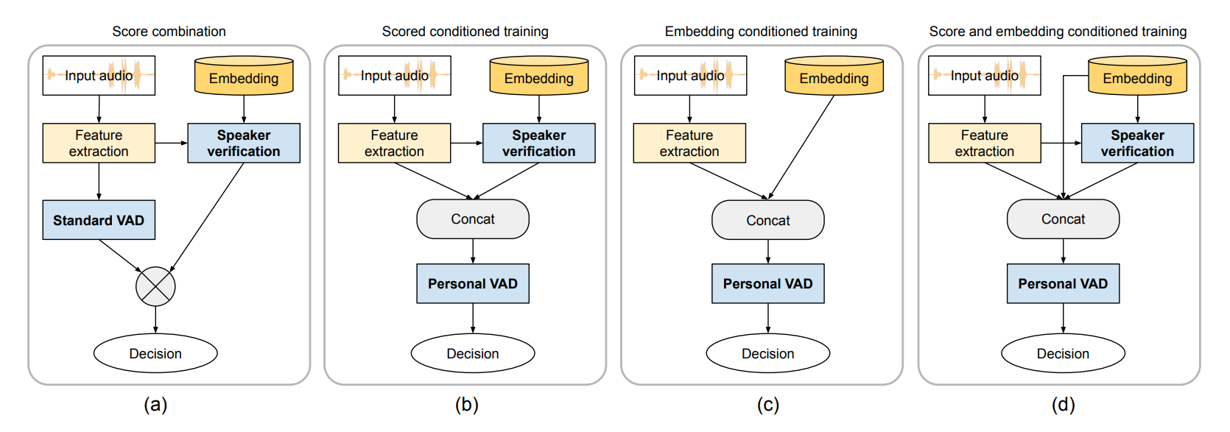
Four architectures for personal VAD

Slide 18
Score combination (SC)
Use standard VAD and speaker verification (no training new model)
We use it as a baseline
Note: Running speaker verification is expensive

Slide 19
Score conditioned training (ST)
Train a new model on feature + score
Note: Running speaker verification is expensive

Slide 20
Embedding conditioned training (ET)
Train a new model on feature + embedding
Note: No need to run speaker verification at runtime; cheap and ideal for device

Slide 21
Score and embedding conditioned training (SET)
Train a new model on feature + score + embedding
Use most information from speaker recognition
Note: Running speaker verification is expensive

Slide 22
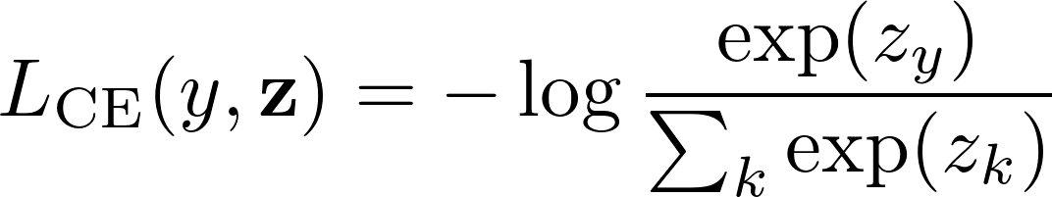
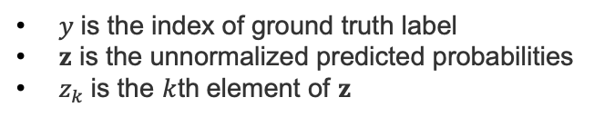
Loss function
Cross-entropy loss (CE)
Standard VAD usually uses binary CE loss
Personal VAD has 3 categories: can simply use ternary CE loss
$y$ is the index of ground truth label
$z$ is the unnormalized predicted probabilities
$z_{k}$ is the $k$th element of $z$

Slide 23
Can we do better than cross-entropy?
For personal VAD, both non-speech (ns) and non-target speaker speech (ntss) will be discarded by downstream components
ASR only triggers on target speaker speech (tss)
Thus the costs for different confusion errors are different

Slide 24
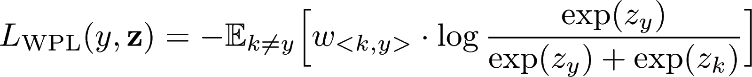
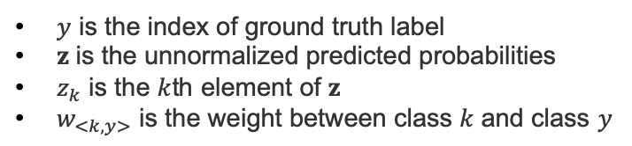
Weighted pairwise loss
We propose weighted pairwise loss (WPL)
Set different weights between different pairs of classes
$y$ is the index of ground truth label
$z$ is the unnormalized predicted probabilities
$z_{k}$ is the $k$th element of $z$
$w_{<k,y>}$ is the weight between class $k$ and class $y$
For example,

Slide 25
Part 4:
Experiment Setup

Slide 26
Ideal dataset
An “ideal” dataset for personal VAD should have:
Realistic and natural speaker turns
Diverse noise conditions
Frame-level speaker labels
Enrollment utterances for each speaker
Unfortunately, we cannot find a good candidate dataset

Slide 27
Dataset
As a proof-of-concept, we make artificial “conversational” speech
Our experiments are based on LibriSpeech:
16kHz read English speech
Derived from read audiobooks
960 hours of clean and noisy speech for training
Clean and noisy speech for testing

Slide 28
Force alignment
VAD frame-level ground truth labels:
Use a pre-trained ASR model
Force align with ground truth ASR transcript
Force align
That’s great. I really like this Pixel phone.
That’s great.
I really like this Pixel phone.
VAD labelling
|ns| s |ns| s |

Slide 29
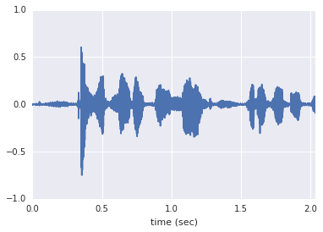
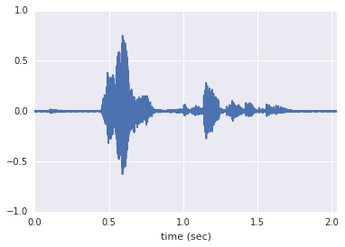
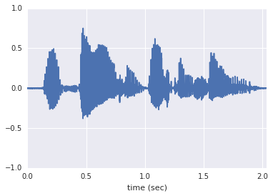
Artificial “conversational” speech
Concatenation: Simulate speaker turns, with ground truth speaker labels
Multi-style training (MTR): Avoid domain overfitting; mitigate concatenation artifacts
Utterance 1
Utterance 2
Utterance 3
Noise source
Room simulator
Artificial conversation
Concatenated utterance
Room config

Slide 30
Model configuration
 | Standard VAD | Personal VAD | Speaker verification
Configuration | 2-layer LSTM, each layer has 64 nodes 1 FC layer with 64 nodes | 2-layer LSTM, each layer has 64 nodes 1 FC layer with 64 nodes | 3-layer LSTM, each layer has 768 nodes and 256-dim projections 1 FC layer with 256 nodes
Number of parameters | 0.13 million | 0.13 million | 4.82 million

Slide 31
Evaluation metrics
Personal VAD is a classification problem
We use Average Precision (AP):
For each class: ns, tss, and ntss
Mean Average Precision over all classes
We also apply MTR on testing data
Explore personal VAD performance on noisy speech
Compare AP w/ and w/o MTR

Slide 32
Part 5:
Results and Conclusions

Slide 33
Architecture comparison
Method | Loss | Without MTR |  |  |  | With MTR |  |  |  | Network params
 |  | tss | ns | ntss | mean | tss | ns | ntss | mean
SC | CE | 0.886 | 0.970 | 0.872 | 0.900 | 0.777 | 0.908 | 0.768 | 0.801 | 4.95M
ST |  | 0.956 | 0.968 | 0.956 | 0.957 | 0.905 | 0.885 | 0.905 | 0.901 | 4.95M
ET |  | 0.932 | 0.962 | 0.946 | 0.946 | 0.878 | 0.873 | 0.890 | 0.883 | 0.13M
SET |  | 0.970 | 0.969 | 0.972 | 0.969 | 0.938 | 0.888 | 0.938 | 0.928 | 4.95M
The proposed systems (ST, ET, SET) significantly outperform baseline (SC)
ET achieve near-optimal performance with 2.6% parameters comparing to SET

Slide 34
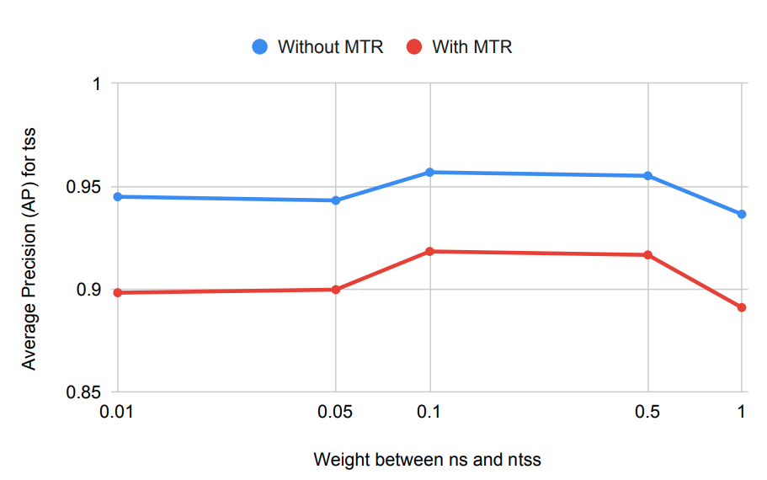
Loss comparison
Method | Loss | Without MTR |  |  |  | With MTR |  |  |  | Network params
 |  | tss | ns | ntss | mean | tss | ns | ntss | mean
ET | CE | 0.932 | 0.962 | 0.946 | 0.946 | 0.878 | 0.873 | 0.890 | 0.883 | 0.13M
 | WPL | 0.955 | 0.965 | 0.961 | 0.959 | 0.916 | 0.883 | 0.920 | 0.912 | 0.13M
WLP achieves optimal performance when setting weight between ns and ntss to 0.1
WLP (weight=0.1) outperforms CE

Slide 35
Personal VAD for standard VAD task
Ultimate goal is to replace standard VAD by personal VAD
Didn’t observe significant performance difference
Method | Loss | Without MTR |  | With MTR
 |  | speech | non-speech | speech | non-speech
Standard VAD | CE | 0.992 | 0.975 | 0.975 | 0.918
Personal VAD (ET) | CE | 0.991 | 0.965 | 0.979 | 0.893
Personal VAD (ET) | WPL | 0.991 | 0.967 | 0.979 | 0.901

Slide 36
Conclusions
Proposed personal VAD architectures outperform the VAD+SV baseline
SET architecture achieved best performance
ET architecture achieved near-optimal performance, with only 2.6% runtime parameters of SET
ET is ideal for on-device deployment
Proposed weighted pairwise loss outperforms cross-entropy
Personal VAD and standard VAD perform almost equally well on a standard VAD task

Slide 37
Part 6:
Future Work

Slide 38
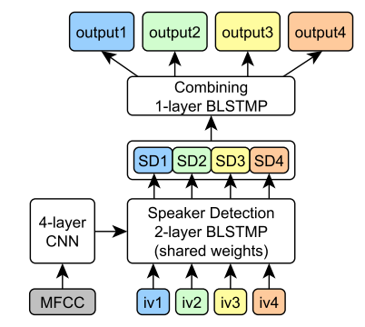
Future work
Training and evaluation on realistic (instead of artificial) conversations
This requires additional data collection and labelling efforts
Personal VAD for speaker diarization (especially with overlapped speech)
Work already exists! “Target-Speaker VAD” system by Ivan Medennikov et al. [1]
[1] Medennikov, Ivan, et al. "Target-Speaker Voice Activity Detection: a Novel Approach for Multi-Speaker Diarization in a Dinner Party Scenario." arXiv preprint arXiv:2005.07272 (2020).

Slide 39
Questions?

